Slide 1
Why Did You Choose CSE?

Slide 2
Introduce With Structural Programming Language And Other Related Terms
Course Title :- Structured Programming Language Sessional
Course Code :- CSE-122
Level Term: 1-II-A(G1) & 1-II-B(G3,G4)
Khandaker Jannatul Ritu, Lecturer(CSE), BAIUST

Slide 3
Content Of This Lecture
Resources will be followed:
Popular Programming languages
Necessary Websites & Tools Related To Programming
Competitive Programming OJ
Structural programming language
Differences Between C, C++ and Java
C Programming Language Tutorial
History of C Language
Advantages/Features of C Language
Applications of C Language
General Overview of a Simple C Program's Structure:
Compilation process in c
Tokens in C
Keywords in C
C Identifiers
C Comments
C Output (Print Text)
C New Lines
Escape Sequence in C
Video Resources to follow

Slide 4
Resources will be followed:
Books:
C: the complete reference
Programming in ANSI-C
C programming by tamim shahriar subin
52 Programming Problem Tamim Shahriar Subeen
Websites:
https://www.w3schools.com/c/index.php
https://www.programiz.com/c-programming
https://www.javatpoint.com/c-programming-language-tutorial
https://www.geeksforgeeks.org/c-programming-language/
https://www.tutorialspoint.com/cprogramming/index.htm
YouTube Tutorials to follow(click on the link):-
C Programming Bangla Tutorials (সবার জন্য সি প্রোগ্রামিং) | Updated in 2023 - YouTube
Khandaker Jannatul Ritu, Lecturer(CSE), BAIUST

Slide 5
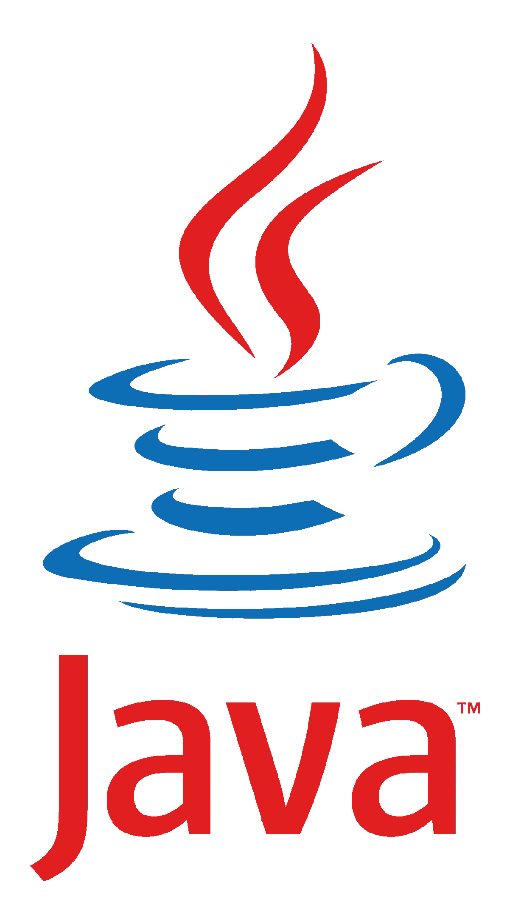

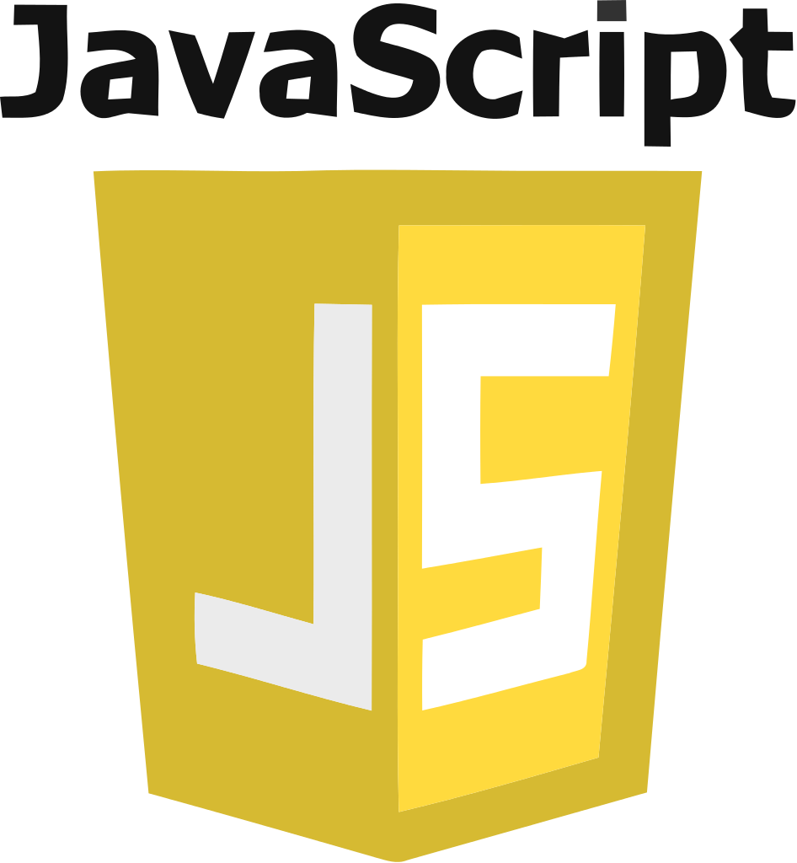




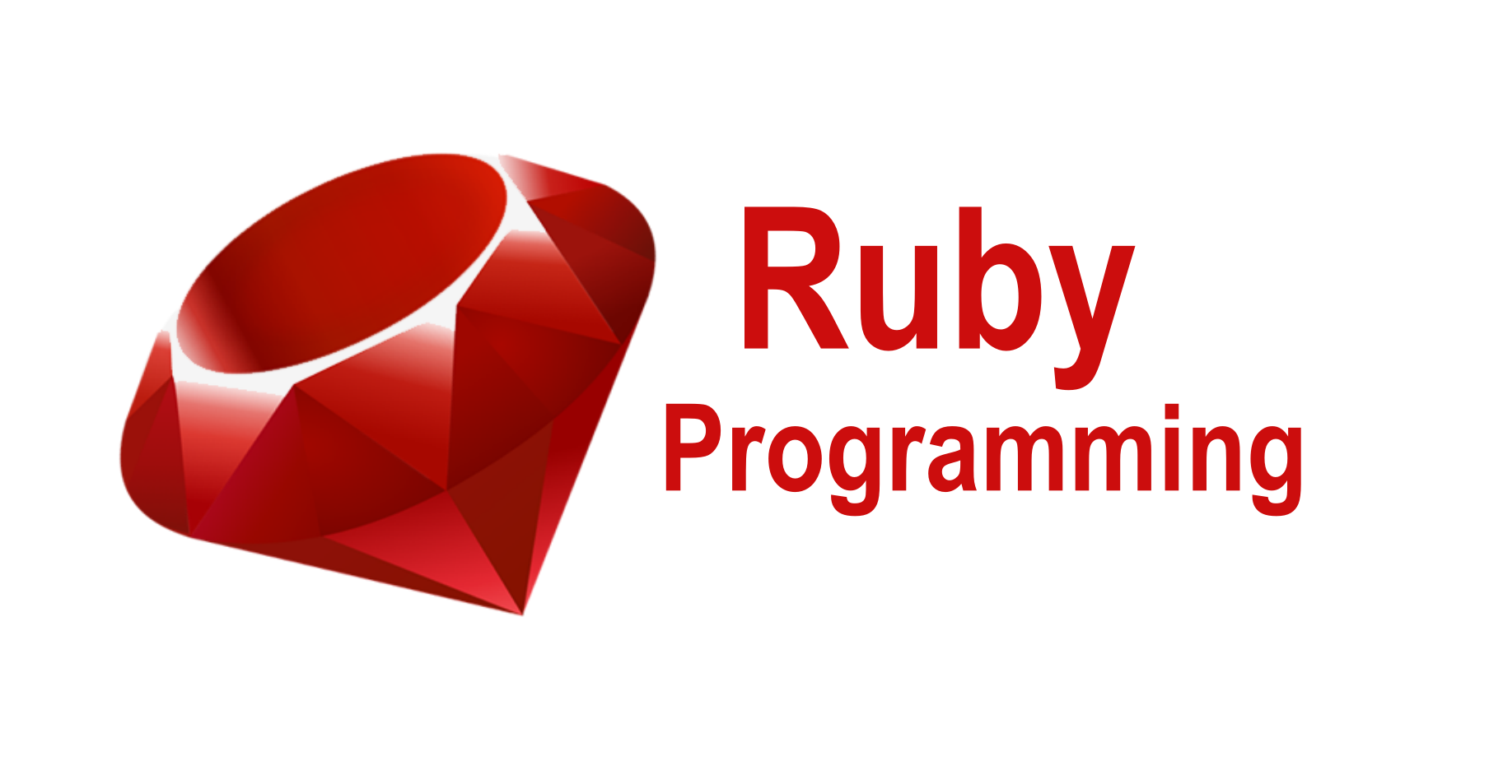


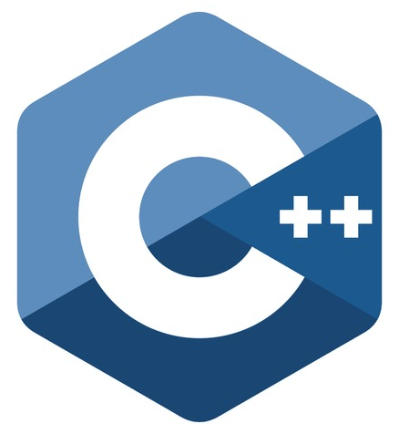
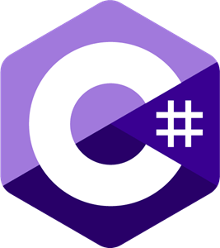
Popular Programming languages
1. Javascript 2. Python 3. Go 4. Java 5. Kotlin 6. PHP 7. C# 8. Swift 9. R 10. Ruby 11. C and C++
Khandaker Jannatul Ritu, Lecturer(CSE), BAIUST

Slide 6





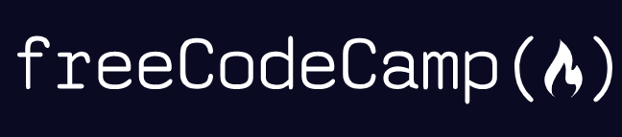







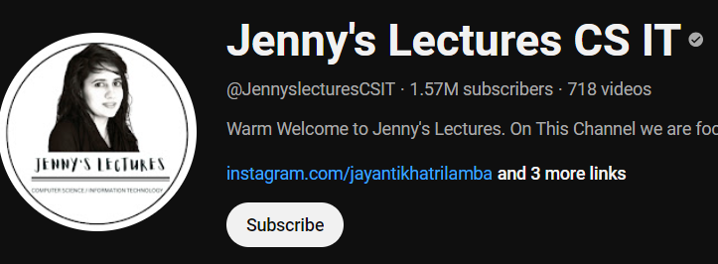




Necessary Websites & Tools Related To Programming

Slide 7
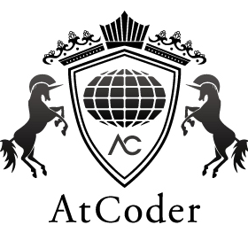










Competitive Programming OJ

Slide 8











Necessary Websites & Tools Related To Programming

Slide 9
Structural programming language
Structured Programming
Structured Programming is a type of programming that generally converts large or complex programs into more manageable and small pieces of code.
These small pieces of codes are usually known as functions or modules or sub-programs of large complex programs.
It is known as modular programming and minimizes the chances of function affecting another.
Exmaples: C,C++, Java, and Python
// C program to demonstrate the structured programming
#include <stdio.h>
// Function for addition
int sum(int a, int b){
return a + b;
}
int main(){
int a = 10, b = 5; // Variable initialisation
int add, minus;
add = sum(a, b); // Function Call
printf("Addition = %d\n", add);
}
Khandaker Jannatul Ritu, Lecturer(CSE), BAIUST

Slide 10
Unstructured Programming:
Unstructured Programming is a type of programming that generally executes in sequential order i.e., these programs just not jumped from any line of code and each line gets executed sequentially.
It is also known as non-structured programming that is capable of creating turning-complete algorithms.
// C program to demonstrate the unstructured programming
#include <stdio.h>
int main()
{
// Variable initialisation
int a = 10, b = 5;
int add, minus;
// Operations performed
add = a + b;
minus = a - b;
printf("Addition = %d\n", add);
printf("Subtraction = %d\n", minus);
return 0;
}
Khandaker Jannatul Ritu, Lecturer(CSE), BAIUST

Slide 11
Tabular Difference Between Structured Vs Unstructured Programming:
Structured Programming | Unstructured Programming
It is basically a subset of procedural programs. | It is basically a procedural program.
In this, programmers are allowed to code a program simply by dividing the program into modules or smaller units. | In this, programmers are not allowed code divide programs into small units. Instead, the program should be written as a single continuous block without any breakage.
It is more user-friendly and easy to understand as compared to unstructured programming. | It is less user-friendly and little hard to understand as compared to structured programming.
It is easier to learn and follow. | It is difficult to learn and follow
Khandaker Jannatul Ritu, Lecturer(CSE), BAIUST

Slide 12
Differences Between C, C++ and Java
S.N. | Basis | C | C++ | Java
1 | Origin | The C language is based on BCPL. | The C++ language is based on the C language. | The Java programming language is based on both C and C++.
2 | Programming Pattern | It is a procedural language. | It is an object-oriented programming language. | It is a pure object-oriented programming language.
3 | Approach | It uses the top-down approach. | It uses the bottom-up approach. | It also uses the bottom-up approach.
4 | Dynamic or Static | It is a static programming language. | It is also a static programming language. | It is a dynamic programming language.
5 | Code Execution | The code is executed directly. | The code is executed directly. | The code is executed by the JVM.
6 | Platform Dependency | It is platform dependent. | It is platform dependent. | It is platform-independent because of byte code.
7 | Translator | It uses a compiler only to translate the code into machine language. | It also uses a compiler only to translate the code into machine language. | Java uses both compiler and interpreter and it is also known as an interpreted language.
8 | File Generation | It generates the .exe, and .bak, files. | It generates .exe file. | It generates .class file.
9 | Number of Keyword | There are 32 keywords in the C language. | There are 60 keywords in the C++ language. | There are 52 keywords in the Java language.
10 | Source File Extension | The source file has a .c extension. | The source file has a .cpp extension. | The source file has a .java extension.
Khandaker Jannatul Ritu, Lecturer(CSE), BAIUST

Slide 13
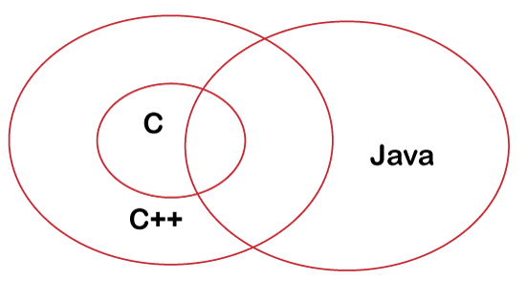
Differences Between C, C++ and Java
Khandaker Jannatul Ritu, Lecturer(CSE), BAIUST

Slide 14
C Programming Language
The C Language is developed by Dennis Ritchie for creating system applications that directly interact with the hardware devices such as drivers, kernels, etc.
C programming is considered as the base for other programming languages, that is why it is known as mother language.
It can be defined by the following ways:
Mother language
System programming language
Procedure-oriented programming language
Structured programming language
Mid-level programming language
1) C as a mother language
C language is considered as the mother language of all the modern programming languages because most of the compilers, JVMs, Kernels, etc. are written in C language, and most of the programming languages follow C syntax, for example, C++, Java, C#, etc.
It provides the core concepts like the array, strings, functions, file handling, etc. that are being used in many languages like C++, Java, C#, etc.
2) C as a system programming language
A system programming language is used to create system software. C language is a system programming language because it can be used to do low-level programming (for example driver and kernel). It is generally used to create hardware devices, OS, drivers, kernels, etc. For example, Linux kernel is written in C.
It can't be used for internet programming like Java, .Net, PHP, etc.
Khandaker Jannatul Ritu, Lecturer(CSE), BAIUST

Slide 15
C Programming Language
3) C as a procedural language
A procedure is known as a function, method, routine, subroutine, etc. A procedural language specifies a series of steps for the program to solve the problem.
A procedural language breaks the program into functions, data structures, etc.
C is a procedural language. In C, variables and function prototypes must be declared before being used.
5) C as a mid-level programming language
C is considered as a middle-level language because it supports the feature of both low-level and high-level languages. C language program is converted into assembly code, it supports pointer arithmetic (low-level), but it is machine independent (a feature of high-level).
A Low-level language is specific to one machine, i.e., machine dependent. It is machine dependent, fast to run. But it is not easy to understand.
A High-Level language is not specific to one machine, i.e., machine independent. It is easy to understand.
4) C as a structured programming language
A structured programming language is a subset of the procedural language. Structure means to break a program into parts or blocks so that it may be easy to understand.
In the C language, we break the program into parts using functions. It makes the program easier to understand and modify.
Khandaker Jannatul Ritu, Lecturer(CSE), BAIUST

Slide 16

History of C Language
C programming language was developed in 1972 by Dennis Ritchie at bell laboratories of AT&T (American Telephone & Telegraph), located in the U.S.A.
Dennis Ritchie is known as the founder of the c language.
It was developed to overcome the problems of previous languages such as B, BCPL, etc.
Initially, C language was developed to be used in UNIX operating system. It inherits many features of previous languages such as B and BCPL.
Let's see the programming languages that were developed before C language.
Language | Year | Developed By
Algol | 1960 | International Group
BCPL | 1967 | Martin Richard
B | 1970 | Ken Thompson
Traditional C | 1972 | Dennis Ritchie
K & R C | 1978 | Kernighan & Dennis Ritchie
ANSI C | 1989 | ANSI Committee
ANSI/ISO C | 1990 | ISO Committee
C99 | 1999 | Standardization Committee
Khandaker Jannatul Ritu, Lecturer(CSE), BAIUST

Slide 17
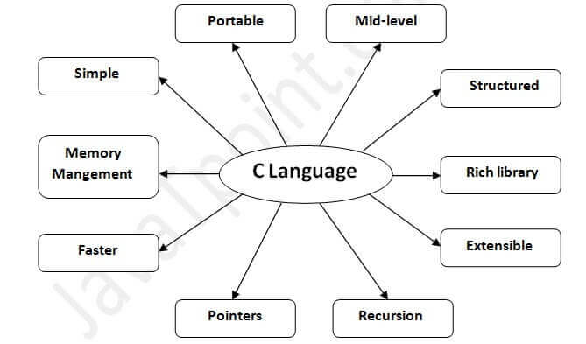
Advantages/Features of C Language
C is the widely used language.
It provides many features that are given below.
Simple
Machine Independent or Portable
Mid-level programming language
structured programming language
Rich Library
Dynamic Memory Management
Fast Speed
Pointers
Recursion
Extensible
Khandaker Jannatul Ritu, Lecturer(CSE), BAIUST

Slide 18
Drawbacks of C Language
The following are the disadvantages/drawbacks of C language −
Manual Memory Management − C languages need manual memory management, where a developer has to take care of allocating and deallocating memory explicitly.
No Object−Oriented Feature − Nowadays, most of the programming languages support the OOPs features. But C language does not support it.
No Garbage Collection − C language does not support the concept of Garbage collection. A developer needs to allocate and deallocate memory manually and this can be error-prone and lead to memory leaks or inefficient memory usage.
No Exception Handling − C language does not provide any library for handling exceptions. A developer needs to write code to handle all types of expectations.
Khandaker Jannatul Ritu, Lecturer(CSE), BAIUST

Slide 19
Applications of C Language
System Programming − C language is used to develop system software which are close to hardware such as operating systems, firmware, language translators, etc.
Embedded Systems − C language is used in embedded system programming for a wide range of devices such as microcontrollers, industrial controllers, etc.
Compiler and Interpreters − C language is very common to develop language compilers and interpreters.
Database Systems − Since C language is efficient and fast for low-level memory manipulation. It is used for developing DBMS and RDBMS engines.
Networking Software − C language is used to develop networking software such as protocols, routers, and network utilities.
Game Development − C language is widely used for developing games, gaming applications, and game engines.
Scientific and Mathematical Applications − Applications such as simulations, numerical analysis, and other scientific computations are usually developed in C language.
Text Editor and IDEs − C language is used for developing text editors and integrated development environments such as Vim and Emacs.
Khandaker Jannatul Ritu, Lecturer(CSE), BAIUST

Slide 20
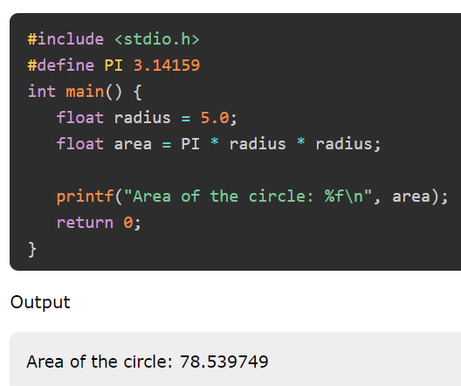
General Overview of a Simple C Program's Structure:
Header Files:
The #include directives at the beginning of the program are used to include header files. Header files provide function prototypes and definitions that allow the C compiler to understand the functions used in the program.
Main Function:
Every C program starts with the main function. It is the program's entry point, and execution starts from here. The main function has a return type of int, indicating that it should return an integer value to the operating system upon completion.
Variable Declarations:
Before using any variables, you should declare them with their data types. This section is typically placed after the main function's curly opening brace.
Khandaker Jannatul Ritu, Lecturer(CSE), BAIUST

Slide 21
General Overview of a Simple C Program's Structure:
Statements and Expressions:
This section contains the actual instructions and logic of the program. C programs are composed of statements that perform actions and expressions that compute values.
Comments:
Comments are used to provide human-readable explanations within the code. They are not executed and do not affect the program's functionality. In C, comments are denoted by // for single-line comments and /* */ for multi-line comments.
Return Statement:
Use the return statement to terminate a function and return a value to the caller function. A return statement with a value of 0 typically indicates a successful execution in the main function, whereas a non-zero value indicates an error or unexpected termination.
// C program to demonstrate syntax of arithmetic operators
#include <stdio.h>
int main()
{
int a = 10, b = 4, res;
res = a + b; // addition
printf("a + b is %d\n", res);
return 0;
}
Khandaker Jannatul Ritu, Lecturer(CSE), BAIUST

Slide 22
General Overview of a Simple C Program's Structure:
Functions:
C programs can include user-defined functions and blocks of code that perform specific tasks. Functions help modularize the code and make it more organized and manageable.
Standard Input/Output:
C has library functions for reading user input (scanf) and printing output to the console (printf). These functions are found in C programs and are part of the standard I/O library (stdio.h header file). It is essential to include these fundamental features correctly while writing a simple C program to ensure optimal functionality and readability.
// C Program to illustrate the use of user-defined function
#include <stdio.h>
// Function prototype
int sum(int, int);
// Function definition
int sum(int x, int y){
int sum;
sum = x + y;
return x + y;
}
int main(){
int x = 10, y = 11;
// Function call
int result = sum(x, y);
printf("Sum of %d and %d = %d ", x, y, result);
return 0;
}
Khandaker Jannatul Ritu, Lecturer(CSE), BAIUST

Slide 23
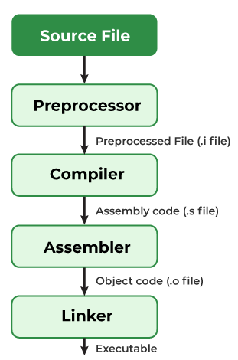
Compilation process in C
What is a compilation?
The compilation is a process of converting the source code into object code. It is done with the help of the compiler. The compiler checks the source code for the syntactical or structural errors, and if the source code is error-free, then it generates the object code.
The c compilation process converts the source code taken as input into the object code or machine code. The compilation process can be divided into four steps, i.e., Pre-processing, Compiling, Assembling, and Linking.
The preprocessor takes the source code as an input, and it removes all the comments from the source code. The preprocessor takes the preprocessor directive and interprets it. For example, if <stdio.h>, the directive is available in the program, then the preprocessor interprets the directive and replace this directive with the content of the 'stdio.h' file.
The following are the phases through which our program passes before being transformed into an executable form:
Khandaker Jannatul Ritu, Lecturer(CSE), BAIUST

Slide 24
Compilation process in C
Preprocessor
The source code is the code which is written in a text editor and the source code file is given an extension ".c". This source code is first passed to the preprocessor, and then the preprocessor expands this code. After expanding the code, the expanded code is passed to the compiler.
Compiler
The code which is expanded by the preprocessor is passed to the compiler. The compiler converts this code into assembly code. Or we can say that the C compiler converts the pre-processed code into assembly code.
Assembler
The assembly code is converted into object code by using an assembler. The name of the object file generated by the assembler is the same as the source file. The extension of the object file in DOS is '.obj,' and in UNIX, the extension is 'o'. If the name of the source file is 'hello.c', then the name of the object file would be 'hello.obj'.
Linker
Mainly, all the programs written in C use library functions. These library functions are pre-compiled, and the object code of these library files is stored with '.lib' (or '.a') extension. The main working of the linker is to combine the object code of library files with the object code of our program.
Khandaker Jannatul Ritu, Lecturer(CSE), BAIUST

Slide 25
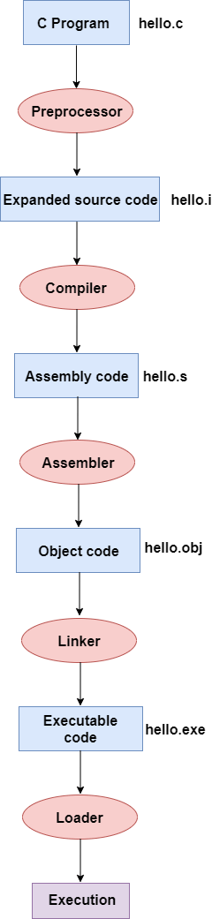
Compilation process in C
Let's understand through an example.
#include <stdio.h>
int main()
{
printf("Hello javaTpoint");
return 0;
}
In the above flow diagram, the following steps are taken to execute a program:
Firstly, the input file, i.e., hello.c, is passed to the preprocessor, and the preprocessor converts the source code into expanded source code. The extension of the expanded source code would be hello.i.
The expanded source code is passed to the compiler, and the compiler converts this expanded source code into assembly code. The extension of the assembly code would be hello.s.
This assembly code is then sent to the assembler, which converts the assembly code into object code.
After the creation of an object code, the linker creates the executable file. The loader will then load the executable file for the execution.
Khandaker Jannatul Ritu, Lecturer(CSE), BAIUST

Slide 26
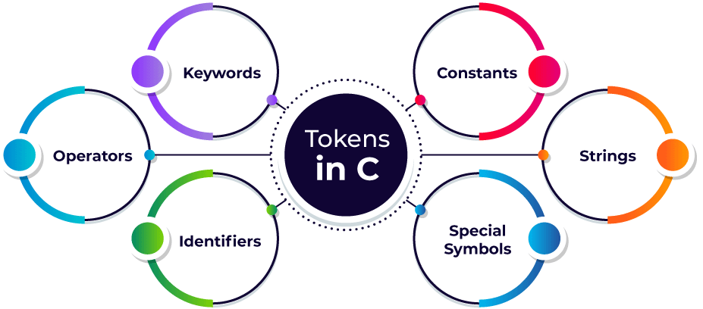
Tokens in C
A token in C can be defined as the smallest individual element of the C programming language that is meaningful to the compiler. It is the basic component of a C program.
A token in C is the meaningful smallest unit used in a C program.
Types of Tokens in C: The tokens of C language can be classified into six types based on the functions they are used to perform.
Khandaker Jannatul Ritu, Lecturer(CSE), BAIUST

Slide 27
Keywords in C
In C Programming language, there are many rules so to avoid different types of errors. One of such rule is not able to declare variable names with auto, long, etc. This is all because these are keywords. Let us check all keywords in C language.
What are Keywords?
Keywords are predefined or reserved words that have special meanings to the compiler. These are part of the syntax and cannot be used as identifiers in the program. A list of keywords in C or reserved words in the C programming language are mentioned below:
auto | break | case | char | const | continue | default | do
double | else | enum | extern | float | for | goto | if
int | long | register | return | short | signed | sizeof | static
struct | switch | typedef | union | unsigned | void | volatile | while
Khandaker Jannatul Ritu, Lecturer(CSE), BAIUST

Slide 28
C Identifiers
Identifiers are unique names that are assigned to variables, structs, functions, and other entities.
Rules to Name an Identifier in C
An identifier can include letters (a-z or A-Z), and digits (0-9).
An identifier cannot include special characters(/,<,>,*,!,~,#,@,$,%,^,&,*) except the ‘_’ underscore.
Spaces are not allowed while naming an identifier.
An identifier can only begin with an underscore or letters.
We cannot name identifiers the same as keywords because they are reserved words to perform a specific task. For example, printf, scanf, int, char, struct, etc.
The identifier must be unique in its namespace.
C language is case-sensitive so, ‘name’ and ‘NAME’ are different identifiers.
✅ Number, num=2, val, VAL=23, number1,number2, a1,a2,
❌ 1num, #val, ^list, $name, ~age, &age
✅ _num1, num1_, customer_list, customer_list1
❌ 1num_, customer-list, 1_num,
✅ customer_list
❌ customer list
✅ INT, PRINTF, CHAR
❌ int = 0, printf=0,
✅ name=0, NAME=0, Name=0, NaMe=0, NAMe=0,namE=0
Khandaker Jannatul Ritu, Lecturer(CSE), BAIUST

Slide 29
C Comments
The comments in C are human-readable explanations or notes in the source code of a C program. A comment makes the program easier to read and understand. These are the statements that are not executed by the compiler or an interpreter.
It is considered to be a good practice to document our code using comments.
When and Why to use Comments in C programming?
A person reading a large code will be bemused if comments are not provided about details of the program.
C Comments are a way to make a code more readable by providing more descriptions.
C Comments can include a description of an algorithm to make code understandable.
C Comments can be used to prevent the execution of some parts of the code.
Types of comments in C
In C there are two types of comments in C language:
Single-line comment
Multi-line comment
Khandaker Jannatul Ritu, Lecturer(CSE), BAIUST

Slide 30
C Comments
Single-line Comment in C
A single-line comment in C starts with ( // ) double forward slash. It extends till the end of the line and we don’t need to specify its end.
Syntax of Single Line C Comment
// This is a single line comment
2. Multi-line Comment in C
The Multi-line comment in C starts with a forward slash and asterisk ( /* ) and ends with an asterisk and forward slash ( */ ). Any text between /* and */ is treated as a comment and is ignored by the compiler.
It can apply comments to multiple lines in the program.
Syntax of Multi-Line C Comment
/*Comment starts
continues
continues
.
.
.
Comment ends*/
Khandaker Jannatul Ritu, Lecturer(CSE), BAIUST

Slide 31
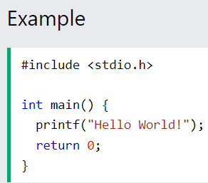
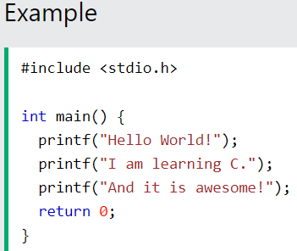
C Output (Print Text)
Output (Print Text)
To output values or print text in C, you can use the printf() function:
You can use as many printf() functions as you want. However, note that it does not insert a new line at the end of the output:
Double Quotes
When you are working with text, it must be wrapped inside double quotations marks "".
If you forget the double quotes, an error occurs.
Output:
Hello World!I am learning C.And it is awesome!
Khandaker Jannatul Ritu, Lecturer(CSE), BAIUST

Slide 32
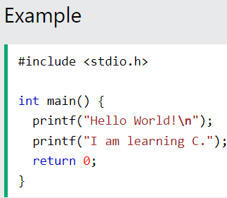
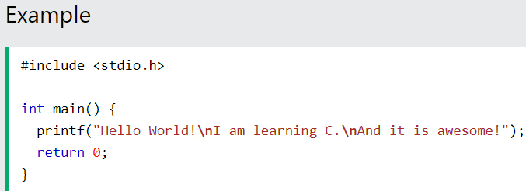
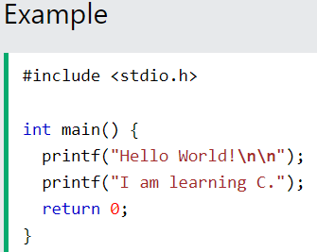
C New Lines
New Lines
To insert a new line, you can use the \n character:
You can also output multiple lines with a single printf() function. However, this could make the code harder to read:
Tip: Two \n characters after each other will create a blank line:
Khandaker Jannatul Ritu, Lecturer(CSE), BAIUST

Slide 33
Escape Sequence in C
The escape sequence in C is the characters or the sequence of characters that can be used inside the string literal. The purpose of the escape sequence is to represent the characters that cannot be used normally using the keyboard. Some escape sequence characters are the part of ASCII charset but some are not.
Escape Sequence | Name | Description
\n | New Line | It moves the cursor to the start of the next line.
\t | Horizontal Tab | It inserts some whitespace to the left of the cursor and moves the cursor accordingly.
\\ | Backlash | Use to insert backslash character.
\’ | Single Quote | It is used to display a single quotation mark.
\” | Double Quote | It is used to display double quotation marks.
\? | Question Mark | It is used to display a question mark.
An escape sequence contains a backslash (\) symbol followed by one of the escape sequence characters or an octal or hexadecimal number.
Khandaker Jannatul Ritu, Lecturer(CSE), BAIUST

Slide 34
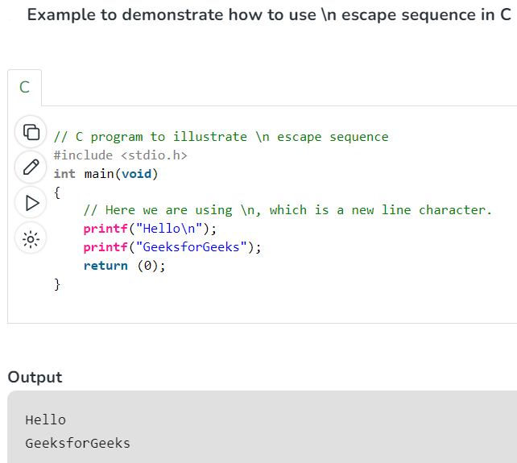
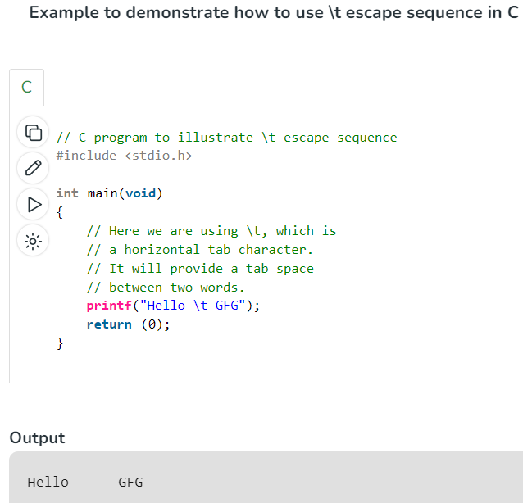
Escape Sequence in C
What is \n exactly?
The newline character (\n) is called an escape sequence, and it forces the cursor to change its position to the beginning of the next line on the screen. This results in a new line.
Khandaker Jannatul Ritu, Lecturer(CSE), BAIUST

Slide 35
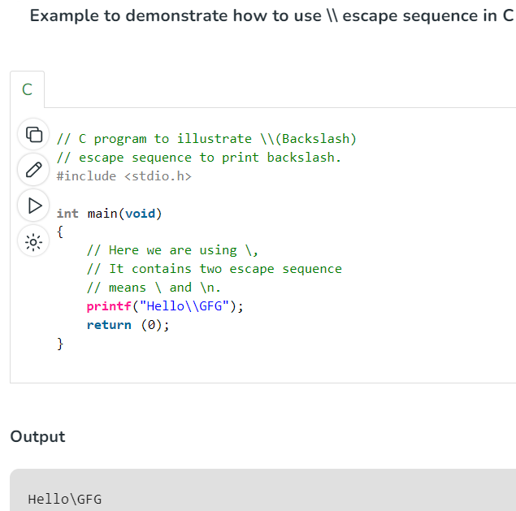
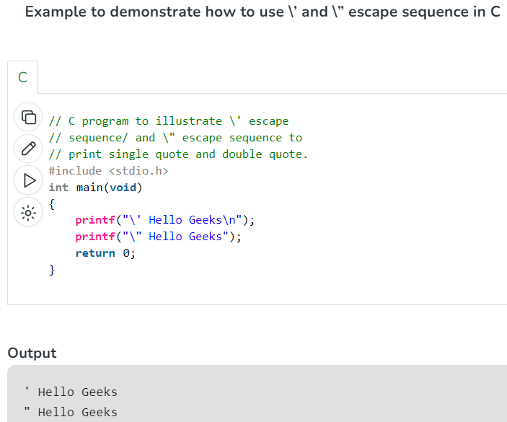
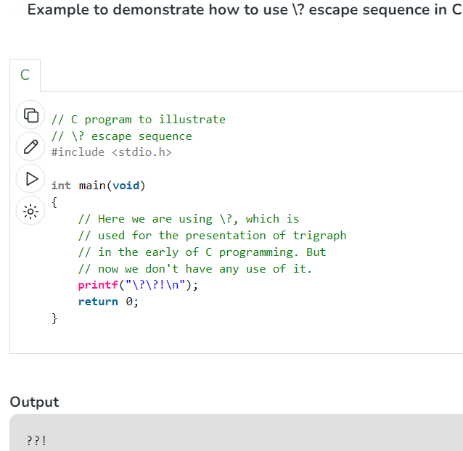
Escape Sequence in C
Khandaker Jannatul Ritu, Lecturer(CSE), BAIUST

Slide 36
Video Resources To Follow(click on the link):-
C programming Bangla Tutorial 5.12 : First C program
C programming Bangla Tutorial 5.13 : Comments and Escape sequence
C programming Bangla Tutorial 5.15 : Keyword, Variable, data type (part-1)
C programming Bangla Tutorial 5.17 : More on data types
Khandaker Jannatul Ritu, Lecturer(CSE), BAIUST

